Slide 1
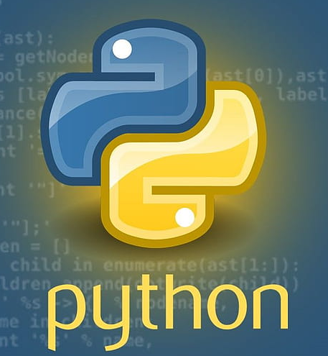
NCRM April 2024: Introduction to Python for data analysis - Session 1: Introduction to course and Python/Installing Python
Lewys Brace
l.brace@exeter.ac.uk

Slide 2
Purpose of this course

Slide 3
Why code?
There are several reason why learning to code is useful:
1. Careers that use coding and programming have great earning potential.
2. The market demand for people with coding and programming skills is strong and will remain so.
3. Due to the wide range of sectors and industries that utilise coding and programming, having these skills offer career flexibility.

Slide 4
Social Data Science/Computational Social Science
You, however, are learning to code on this course because you’re interested in using these skills in order to analyse large datasets to explore social issues.
We refer to this as social data science or computational social science, and can more formally be defined as:
An interdisciplinary field that combines scientific methods, statistical techniques, and computational methods such as the use of algorithms and machine learning (often referred to as artificial intelligence) and processes in order to gain actionable insights from large, sometimes unstructured and “noisy”, data.

Slide 5
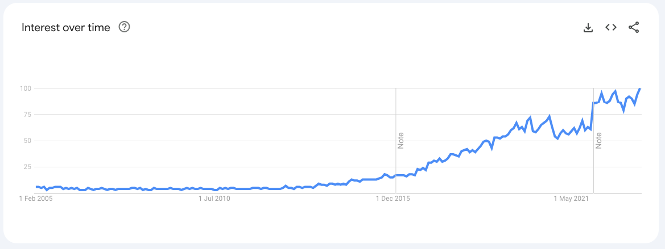
A growing field of interest
This increase is being driven by two factors.

Slide 6
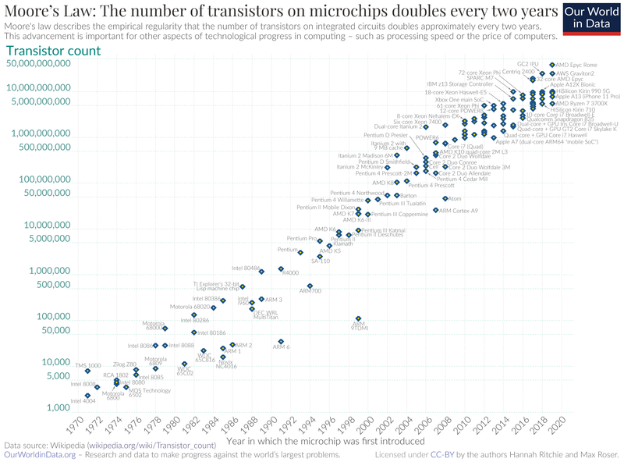
Computing power
Computing power is increasing at an incredibly fast rate.
Moore’s Law posits that computing power will becoming significantly faster, smaller and more efficient over time.
Name after Gordon Moore, who argued that the number of transistors in microchips would double every 2 years.

Slide 7
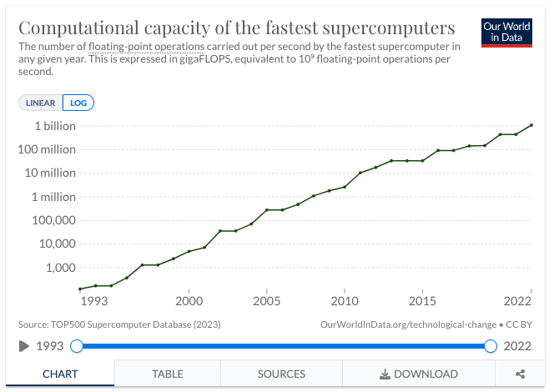
As computing power and speed increases, computer systems are able to process and analyse increasingly large datasets.
Source: https://ourworldindata.org/grapher/supercomputer-power-flops

Slide 8

The data generating society…
The internet has changed all of our interactions, whether it be social, shopping, governmental, educational, or healthcare.
As this digitisation of society continues, we’re producing increasing amounts of digital data.
Many businesses and public organisations attempt to effectively exploit these data to both increase profits and operate more efficiently in the information age.

Slide 9
Exploring social issues with data
Combined, this constant and exponential increase in computational power and the digitation of society:
1. Is posing new social issues that need to be understood.
2. These new large, and often noisy, datasets provide new ways of researching much older social issues.
This is what social data scientists/computational social scientists do, but they require the programming and coding skills and knowledge of other aspects of data analysis to do so.
This is what you’ll learn on this course.

Slide 10

Learning Python
This course is going to be an interactive, where the information provided to you will be accompanied by practical exercises.
There are 4 main aims of this course:
1. Teach you the basics of the python programming language.
2. Teach you how to use python for basic data cleaning and analysis.
3. Teach you the theories behind descriptive and some inferential statistical analysis.
4. Provide you with an overview of other computational methods that will be useful to you during the course of your studies and post-university careers.

Slide 11
What is Python?

Slide 12
What is Python?
Python is a high-level, interpretive, open-source generic programming language with a “batteries included” philosophy.
There 4 important aspects to note here:
1. Generic programming language.
2. High-level
3. Interpretive
4. Open-source
5. “Batteries included” philosophy

Slide 13

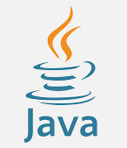


1. Generic programming languages
A general-purpose programming language is one that is designed to be used in the widest possible variety of contexts.
This means that generic programming languages do not include language constructs that are designed to be used within a specific application domain.
This is in contrast to other forms of languages, such as R for example, where the constructs are designed to carry out specific tasks.

Slide 14
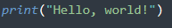
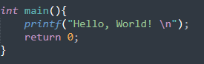
2. High-level language
High-level programming languages are ones with “strong abstraction from the details of the computer”.
Such languages have features such as syntax that is more similar to human language and automate significant aspects of computing such as memory management.
In contrast, C and C++ are now considered low-level programming languages because they have no automatic memory management.
These high-level languages allow programmers to write scripts that are more or less independent of a particular type of computer.
The amount of abstraction defines how high-level a language is.

Slide 15
3. Interpretive vs compiled languages
Python is an interpretive language.
This means that your code is not directly run by the hardware. It is instead passed to a virtual machine, which is just another programme that reads and interprets your code. If your code used the ‘+’ operation, this would be recognised by the interpreter at run time, which would then call its own internal function ‘add(a,b)’, which would then execute the machine code ‘ADD’.
This is in contrast to compiled languages, such as C, where your code is translated into native machine instructions, which are then directly executed by the hardware. Here, the ‘+’ in your code would be translated directly in the ‘ADD’ machine code.
In short, with a compiled language the target machine directly translates the program. In an interpreted language, the source code is not directly translated by the target machine.

Slide 16
4. Open-source
Python is open-source, which means it is free to use.
While certain IDEs (integrated development environment), such as PyCharm, require a fee to use, the language and all of its modules are free to use.
We’ll be using the Anaconda distribution of Python in this module, which is open-source for users such as us.
The modules are maintained by users for users; i.e. people with genuine interest in coding and/or the substantive area that there module is concerned with.
The term “open-source” in this sense should not be confused with the use of the term in other fields; i.e. Open-Source Intelligence, which refers to the use of publicly available information in order to be an intelligence case.

Slide 17
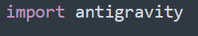
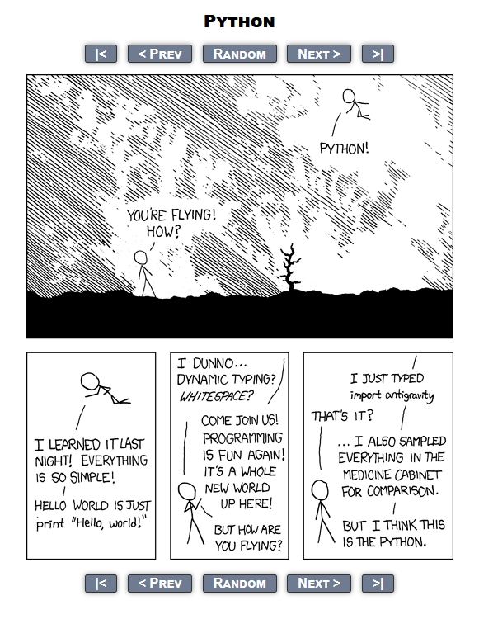
5. “Batteries included” philosophy
This refers to the way in which Python has pieces of code that are designed to carry out specific tasks, and which can be imported and used by a programmer in order to save them from having to write code to carry out every single task.
These are called modules.
In Python, these modules are loaded into your Python script by using the 'import' function.
There are modules for most tasks. For example:

Slide 18
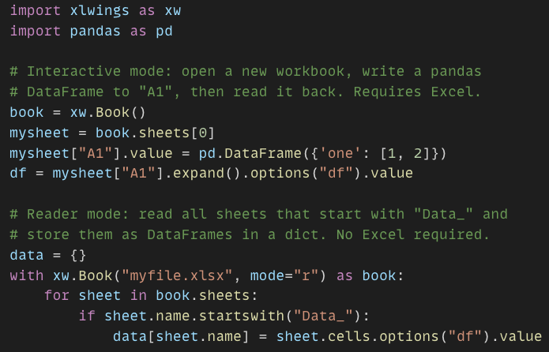
Advantages of Python
Because Python is an interpretive language, it has a number of advantages:
1. Automatic memory management.
2. Expressivity and syntax that is ‘English’.
3. Ease of programming.
4. Minimises development time.
5. Python also has a focus on importing modules, a feature that makes it useful for scientific computing.

Slide 19
Disadvantages of Python
However, Python does also have a number of disadvantages:
1. Interpreted languages are slower than compiled languages.
2. The modules that you import are developed in a decentralised manner; this can cause issues based upon individual assumptions.
3. Multi-threading was traditionally difficult in Python.

Slide 20
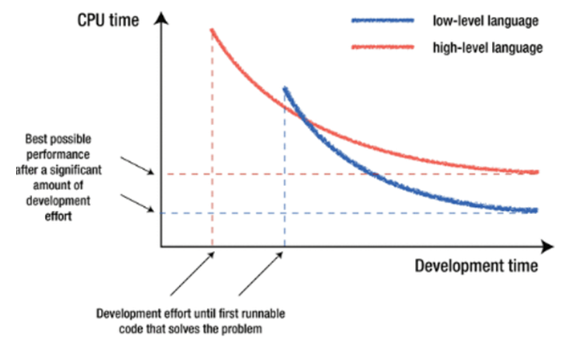
So, which is best?
No one language is better than all others.
The ‘best’ language depends on the task you are using it for and your personal preference.

Slide 21
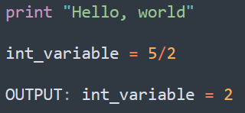
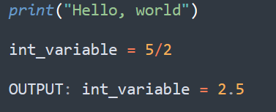
A note on versions of Python
When looking up example code/issues on sites such as Stack Overflow, you are likely to encounter two slightly different syntax for Python.
These correspond to the syntax for Python 2 and Python 3.
Important to note since Python 3 is not backward compatible with Python 2.
A lot of the imported modules were only available in Python 2 for quite some time, leading to a slow adoption of Python 3.
This is not the case anymore, and the vast majority of users code in Python 3.
Support for Python 2 ended in 2020.
Python 2 syntax
Python 3 syntax

Slide 22
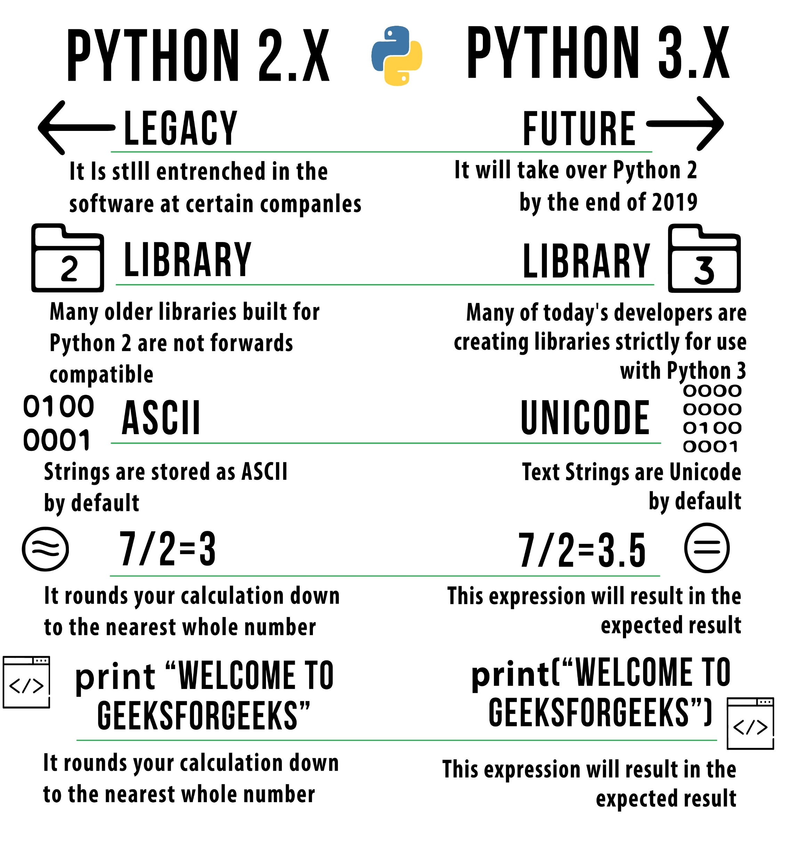

Slide 23
Understanding your computer.

Slide 24
File paths
File paths are crucial for anyone who is working with computer code to understand.
Technically speaking, a file path is a string of characters used to identify a location in a directory structure.
They are composed in such a way that components (folders) are separated between levels by a delimitating character.
The delimitating character is usually a \ or :
These paths represent directory/file relationships.
In a non-technical sense, they are a list of increasingly sub-directories; like tree branches.

Slide 25
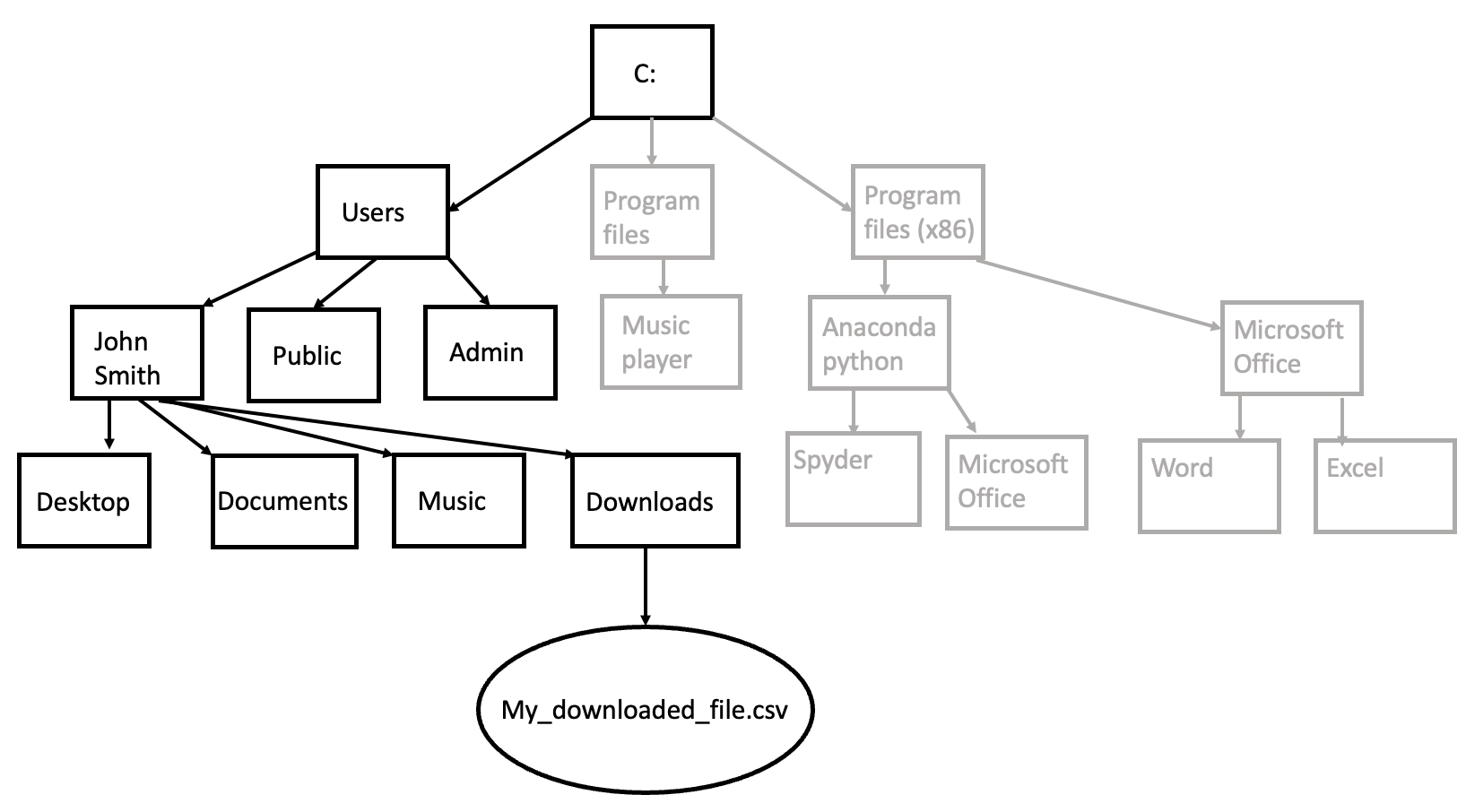
Windows absolute path
C://Users/JohnSmith/Downloads/My_downloaded_file.csv

Slide 26
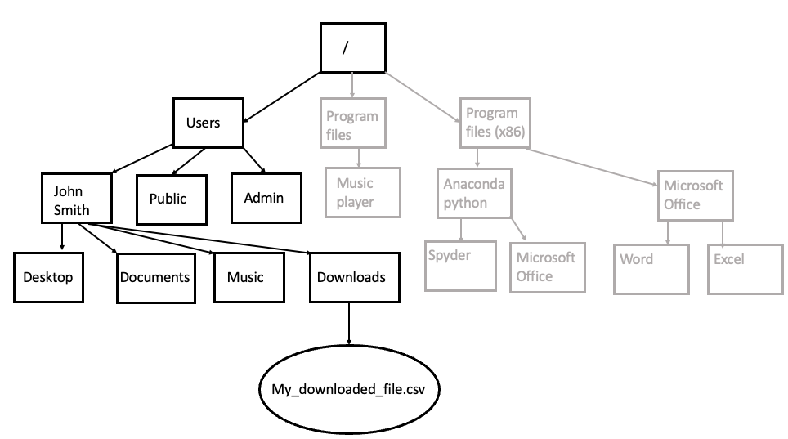
Mac absolute path
/Users/JohnSmith/Downloads/My_downloaded_file.csv

Slide 27
Absolute vs relative paths
The absolute path includes the root directory, and will therefore always point to the same location on a machine:
Windows:
C://Users/JohnSmith/Downloads/My_downloaded_file.csv
Mac:
/Users/JohnSmith/Downloads/My_downloaded_file.csv
In contrast, a relative path begins from some working directory, and therefore does not require an absolute path:
Downloads/My_downloaded_file.csv
If the working directory is the most sub-folder, then the filename itself can constitute a relative path:
My_downloaded_file.csv

Slide 28
Setting up your scientific computing environment.

Slide 29
Command line computing
Doing CSS sometimes involves working with the command line or “in the terminal”
While this may seem archaic given the proliferation of nice GUIs (Graphical User Interfaces), learning how to use the command line to a basic level enables access to a lot of useful tools and functions; i.e. access and using remote machines.
Regardless of which operating system you are using, the command line is the common point of departure.
When we are “working in the terminal” or “command line”, we mean we are interacting with a program called the shell, which we interact with by typing commands into the terminal.

Slide 30
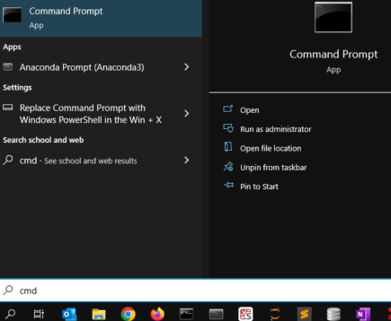
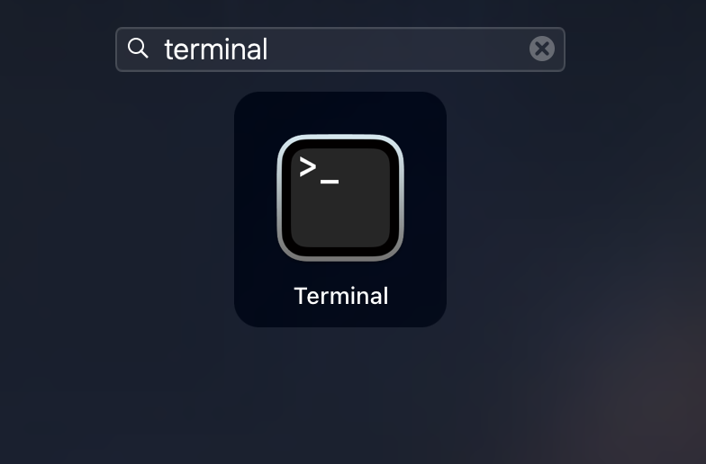
The shell
All Operating Systems (OS) come with pre-installed terminal applications.
As we’ll see later in the course, these might not be the ones we actually want to use for our work, but for the time being, we’ll be using these default ones.
Let’s open the terminal.
Windows:
Click on the search icon in the task bar.
Type CMD
3. Click on the command prompt app icon to open.
Mac:
Click the launchpad
In the search bar, type terminal
3. Click on the terminal app icon to open.

Slide 31
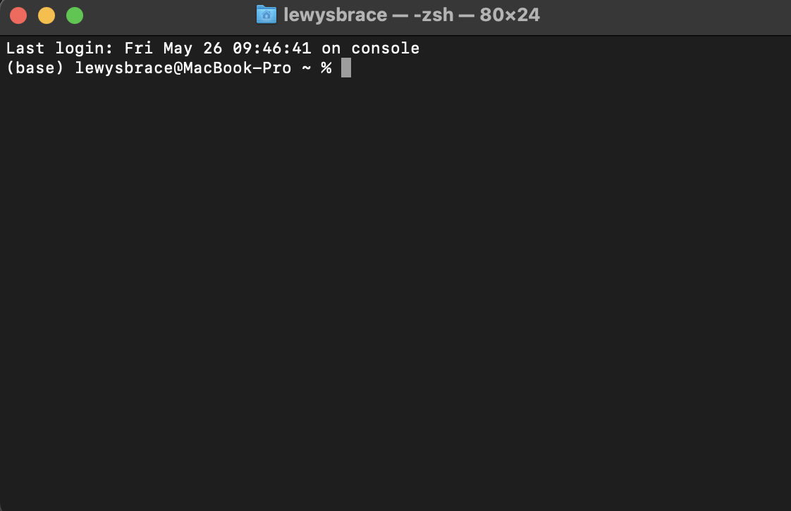
While the appearance of the terminal will vary slightly, depending on the OS you are using, you should see an black screen with username@computername$

Slide 32
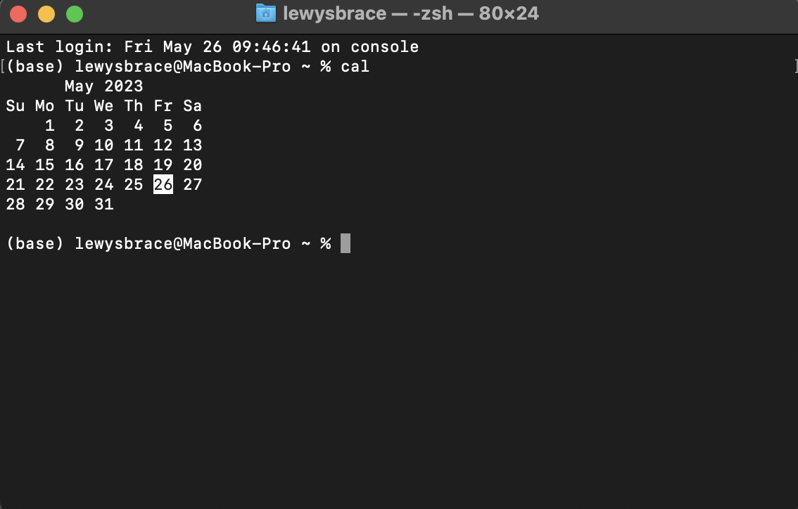
Using the terminal involves providing it with commands and running them by pressing the return/enter button.
For example, we’re going to type use the cal command, which executes the calendar programme.

Slide 33
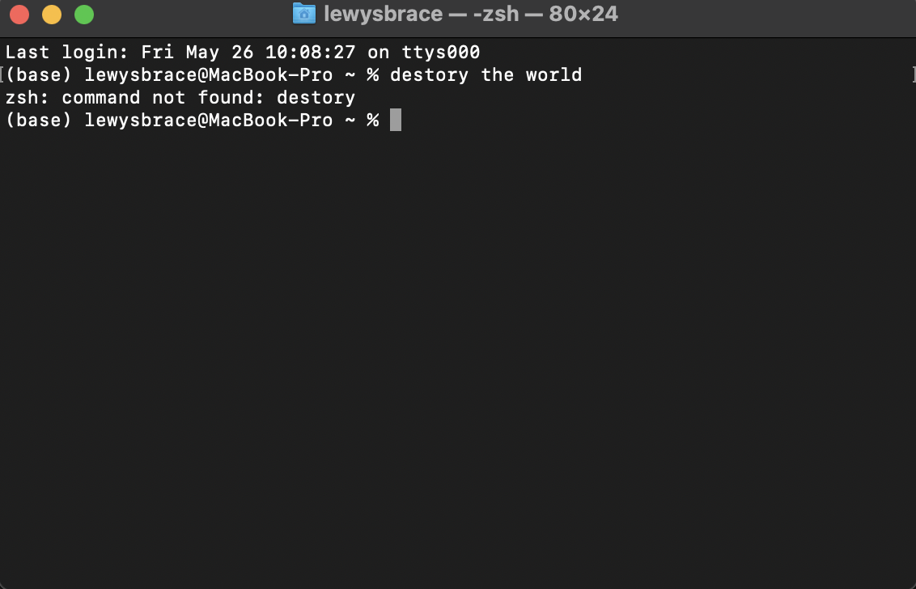
If you type an incorrect command, nothing bad will happen, you’ll just be told it doesn’t exist
We can do almost whatever we want in the terminal, but we have to use the right commands.

Slide 34
Structure of shell commands
Commands will have the same structure, regardless of their function.
However, various parts of the command might be called different things by different people; i.e. ”options” and “arguments” are used interchangeably.
The structure is:
[COMMAND] + [OPTIONS(S)] + [ARGUMENT(S)]
COMMAND: This is the command itself or the name of the program you want to execute.
OPTIONS: The default behaviour of this command or program can then be modified using various options. These come in long (i.e. ls –long) and short (i.e. ls –l) form. When using the latter, multiple options can be strung together with a single - ; i.e. ls –lts
ARGUMENTS: These are commonly the name of the file or the directory that you wish the program to act on
So, if we wanted to run a python script in the terminal:
python3 myscript.py

Slide 35
Default terminal applications
With Linux, the default terminal application is fine.
Same is true for Mac, although it may be worth upgrading to the iTerm2 terminal due to extra functionality.
With Windows, you might need to familiarise yourself with one of a number of other options later in your career, such as:
- Cmder terminal
- Chocolatey

Slide 36
Essential command line commands
Command | Action | Example
pwd | Print current working directory | pwd
cd | Change directory | cd ..
ls | List directory contents | ls -lts
mkdir | Make a new directory | mkdir figures tables
touch | Make a new text file | touch search_log.txt
rm | Remove file/directory | rm output
cp | Copy file/directory | cp document_draft submitted_document
mv | Move file/directory | mv document_draft submitted_document
grep | Search files for a pattern
open | Open a file or directory in the default application | open search_log.txt
history | Print the history of commands issued to the shell | history

Slide 37
Good text editor
A good text editor is essential for working with computer code and should therefore form part of your computational research toolkit.
You will often come across disagreement between people regarding which is best, but these are some of my preferred open-source options:
- VS Code (https://code.visualstudio.com/), which has some good Python extension and out-of-the-box support for working with remote machines.
- Sublime text (https://code.visualstudio.com/)
- Notepad++ (https://notepad-plus-plus.org/downloads/)

Slide 38

A Python distribution
We also obviously need a Python distribution, and for this course, we’ll be using the open-source Anaconda distribution: https://www.anaconda.com/download
Python has a lot of useful tools for doing data analysis, with these computing research tools coming under the ‘scientific Python’ ecosystem.
While we can install each of these packages and tools separately, the Anaconda Python 3 distribution bundles the majority of these tools together, meaning that it is ready to do social data science ‘out of the box’.
In addition to all of these importable packages that can be used for data science, the Anaconda distribution has three main components that we’ll use on this course.

Slide 39

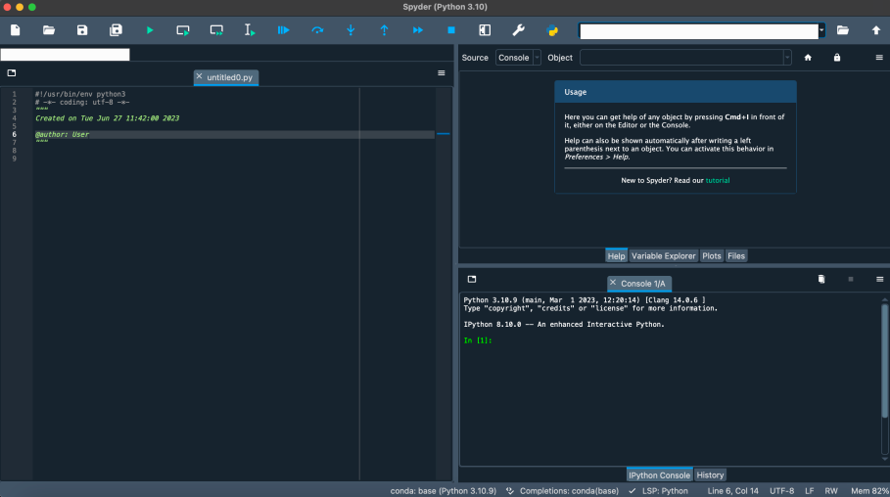
The Spyder IDE
The Spyder Integrated Development Environment (IDE) is great for developing and running Python code.
One you have installed Anaconda, you’ll be able to open Spyder by clicking on the Spyder Icon (top right of this slide) in the Anaconda Navigator.
Once Spyder has opened, you'll be greeted with the window below This is the Spyder IDE.
You can type your code in the text editor box on the left and get your output printed to the screen on the bottom right-hand side box.
You then run your code by clicking the green play button at the top of the window or by pressing F5.

Slide 40
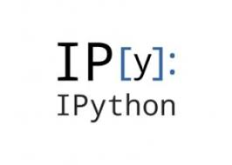
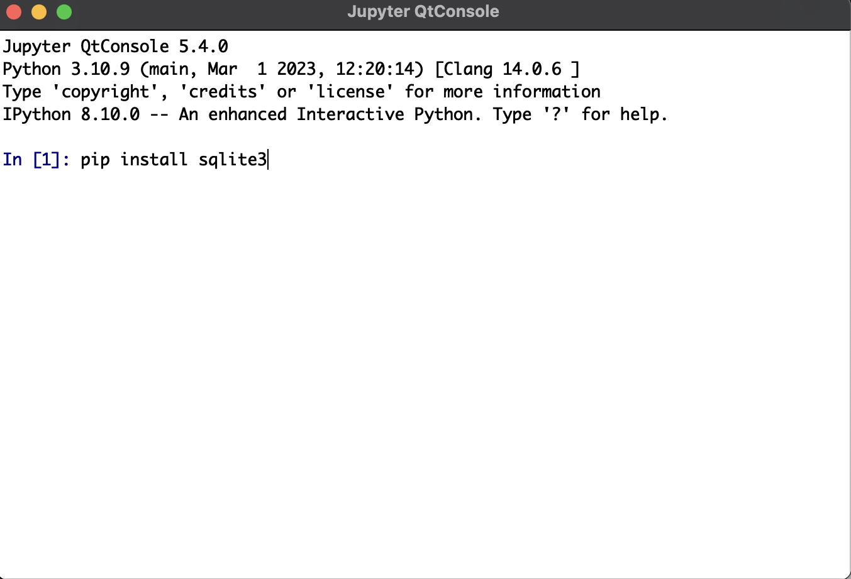
Anaconda prompt for pip installing
The Anaconda Prompt is a special command line tool for downloading and installing Python packages.
This is done using pip, which we’ll cover later in the course.
For the time being, all you need to know about pip is that it is an incredibly easy way to install Python packages that are not already on your system.
To do so, just open up the Anaconda Prompt, which you'll notice looks a lot like the terminal/command line window from earlier
Then to install a package, you then just have to type “pip install”, then the package name, then hit enter. For example, to install the swlite3 package:

Slide 41

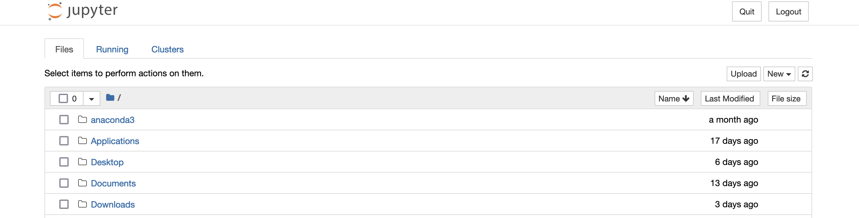
Jupyter Notebooks
Jupyter Notebooks is another and different IDE to Spyder.
The difference is that Jupyter Notebooks these allow you to mix narrative text, code that can be run, inline figures and tables, and equations in a form of interactive notebook.
This makes Jupyter notebooks and incredibly useful teaching tool, so some of the ’slides’ for this module will actually be in Jupyter Notebook form.
Jupyter Notebooks run in your browser. So clicking on the Jupyter Icon in the Anaconda Navigator will open Jupyter in your default web browser.
When you open Jupyter, you’ll be greeted with folder structure you can use to navigate to the folder that contains your Jupyter Notebook file.
Jupyter Notebook files have the .ipynb extension

Slide 42
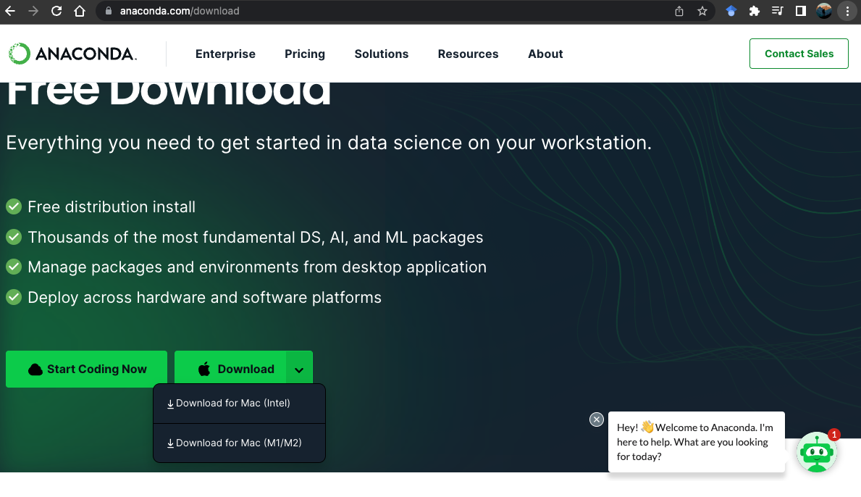
Installing Anaconda
To install Anaconda, go to https://www.anaconda.com/download click on the downward arrow next to the “Download” button.
The website should then automatically detect which version of Anaconda you need.
Once downloaded, follow the onscreen prompt, which will talk you through the installation process.

Slide 43

Opening Anaconda apps
Once installation has finished, you can open the various Anaconda apps via the terminal, or through the program list if you are using Windows.
However, for beginners it is useful to open the Anaconda Navigator by clicking on it’s icon in the program list (if using Windows) or in the Finder (if using Mac OS).
Doing so, will open the following screen, from which you can launch whichever Anaconda app you need.

Slide 44
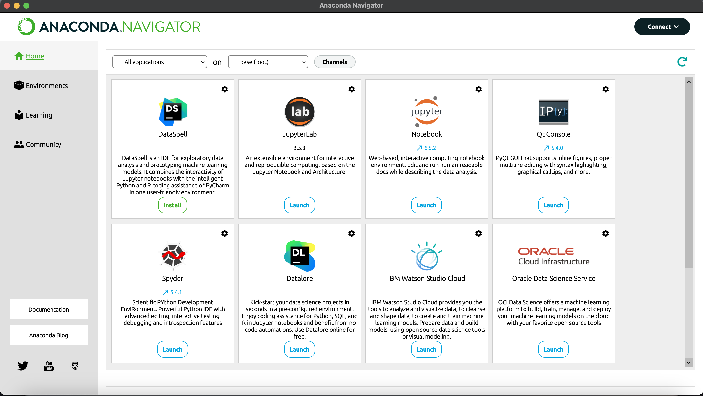

Slide 45
Checking installation was successful
Go through each of the 3 Anaconda apps we discussed, Spyder, IPython QTConsole, and Jupyter, launch them via the Anaconda Navigator and see if they open correctly.

Slide 46
Any questions?

